Slide 1

A3-PS022-TC050
eBPF/XDP Rate Limiting for DNS Query Floods in a Lab
Team Members: Prarthana Puthan Purayil, Richa Felix
Mentored by: Dr. Shamanth N
prarthana.puthan@btech.christuniversity.in
AIORI Hackathon 3
October 31, 2026

Slide 2
AIORI 3
Abstract
Problem Description
Clear outline of the problem being addressed. Use bullet points for key issues.
• Volumetric UDP DNS Floods: High-rate UDP query floods overwhelm Linux server network stacks, causing buffer exhaustion and high packet drop rates at the application layer.
• Kernel Memory & Socket Overhead: In standard Linux networking, every incoming packet undergoes early driver processing, DMA transfers, and sk_buff structure allocation. Under flood conditions, this consumes excessive CPU cycles before packet legitimacy is evaluated.
• Service Degradation for Legitimate Queries: Saturated network queues lead to severe latency spikes and dropped requests for valid DNS queries, effectively causing Denial of Service (DoS) for critical infrastructure services.
• Inefficiency of User-Space Filtering: Traditional firewalls or application-level rate limiters execute post-context switch, meaning the kernel has already expended substantial CPU resources processing malformed or malicious queries.
• Necessity for In-Kernel Early Drops: High-throughput DNS defense requires ultra-early packet inspection directly at the NIC driver layer, dropping flood traffic prior to socket buffer allocation.
Prarthana Puthan Purayil, Richa Felix • A3-PS022-TC050 • October 31, 2026
2 / 11

Slide 3
Background
AIORI 3
Background
It should capture the background necessary to understand the problem and the proposed optimization
• DNS & UDP Query Processing: DNS operates predominantly over connectionless UDP (port 53), making it susceptible to rapid query bursts without TCP handshake overhead.
• Linux Networking Traversal Path: Ingress packets traverse NIC Hardware Ring → Driver DMA → sk_buff Allocation → IP/UDP Stack → Socket Buffer → User-space DNS Daemon (e.g., BIND9/Unbound).
• eBPF (Extended Berkeley Packet Filter): eBPF provides a sandboxed, event-driven bytecode execution engine inside the Linux kernel, enabling safe custom logic without modifying kernel source code [1].
• XDP (eXpress Data Path): XDP offers the lowest-level packet processing hook in the Linux network stack, running directly inside the NIC driver prior to memory (sk_buff) allocation.
• Early Packet Action Primitives: XDP programs return XDP_DROP to discard packets instantly at line-rate, or XDP_PASS to forward valid traffic to the OS network stack.
• Trade-offs & Verification Constraints: XDP provides nanosecond-level packet processing but enforces strict verifier constraints (bounded loops, memory boundary safety, and limited runtime complexity).
Prarthana Puthan Purayil, Richa Felix • A3-PS022-TC050 • October 31, 2026
3 / 11

Slide 4
Literature & RFC Review
AIORI 3
Literature & RFC Review
Do a detailed study of exisiting proposals, studies and standards. But only mention the most relevant ones
• RFC 1034 & RFC 1035 — Domain Name Standards [1]: Establishes the authoritative specifications for DNS message format, header structure (ID, Flags, QDCOUNT), and UDP transport conventions.
• Linux Kernel eBPF/XDP Documentation [2]: Outlines the formal architecture for eBPF kernel sub-systems, verifier safety checking, driver-level Native XDP vs Generic XDP deployment, and lockless BPF map primitives.
• nftables Baseline Packet Filtering [3]: Netfilter framework replacement providing kernel-level packet classification; operates after SKB creation, introducing higher per-packet memory and CPU overhead compared to XDP.
• High-Performance eBPF/XDP DDoS Research [4]: Peer-reviewed benchmarks demonstrate that driver-level XDP filtering handles up to 10x higher packet rates and reduces CPU overhead by over 70% compared to iptables/nftables under high-rate UDP floods.
Prarthana Puthan Purayil, Richa Felix • A3-PS022-TC050 • October 31, 2026
4 / 11

Slide 5
Proposed Solution
AIORI 3
Proposed Solution
Detailed description of the overall solution.
System Architecture & Operational Workflow:
1. Host A (Traffic Generator) generates synthetic DNS query floods and legitimate DNS queries over an isolated link.
2. Host B (XDP Filter Target) receives raw packets at its network interface.
3. An XDP program intercepts incoming packets at the NIC driver layer prior to OS network stack allocation.
4. Bounded C packet parser safely validates Ethernet, IPv4/IPv6, and UDP headers, extracting DNS Query ID & QDCOUNT.
5. Per-Source IP rate limits (via BPF_MAP_TYPE_LRU_HASH) and Global query rate limits are verified in nanoseconds.
6. Traffic exceeding rate thresholds is immediately dropped via XDP_DROP.
7. Permitted DNS queries pass through XDP_PASS to the OS stack for fulfillment by the DNS server (BIND9/Unbound).
8. User-space control daemon polls BPF ring buffers to export real-time drop statistics, throughput, and latency metrics.
Technology Stack: Linux (Kernel 6.x), C (eBPF Kernel Code), XDP (Native/Generic Hook), Clang/LLVM, libbpf, Python (Automation & Metrics), nftables (Baseline).
Prarthana Puthan Purayil, Richa Felix • A3-PS022-TC050 • October 31, 2026
5 / 11

Slide 6
AIORI 3
Solution Optimization
Optimization Proposed
List of optimizations and enhancements. Use a table to compare before and after scenarios.
Key Architectural Optimizations:
• Zero-SKB Allocation Overhead: Drops unwanted DNS flood traffic directly at NIC driver before kernel memory allocation.
• Dual-Tier Rate Limiting: Lockless BPF LRU maps for per-source IP tracking combined with atomic global query counters.
Metric / Scenario | No-Filter Baseline | nftables Baseline | Proposed eBPF/XDP Solution
Filtering Layer | User-Space Socket Drop | Netfilter (Post-SKB) | NIC Driver (Pre-SKB XDP Hook)
Processing Overhead | High (Full Kernel Stack Traversal) | Medium (SKB & Netfilter Rules) | Ultra-Low (Nanosecond Driver Hook)
Hypothesized CPU Load @ Flood | ~95 – 100% (CPU Saturated) | ~60 – 75% (Kernel Netfilter Overhead) | ~15 – 25% (Minimal Driver Load)
Hypothesized Packet Drop Rate | 0% Early (Server Queue Overflow) | ~70 – 80% (Limited by SKB Alloc) | > 98% (Early Line-Rate Drops)
Max Throughput Capacity | ~1.2 Mpps (System Limit) | ~3.5 Mpps (Netfilter Bound) | > 10 Mpps (Driver Line-Rate)
Legitimate Query Success | < 20% (High Queue Drops) | ~65 – 75% (Buffer Contention) | > 95% (Protected Channel)
* Note: Performance metrics represent target hypotheses to be empirically benchmarked during laboratory experimentation.
Prarthana Puthan Purayil, Richa Felix • A3-PS022-TC050 • October 31, 2026
6 / 11

Slide 7
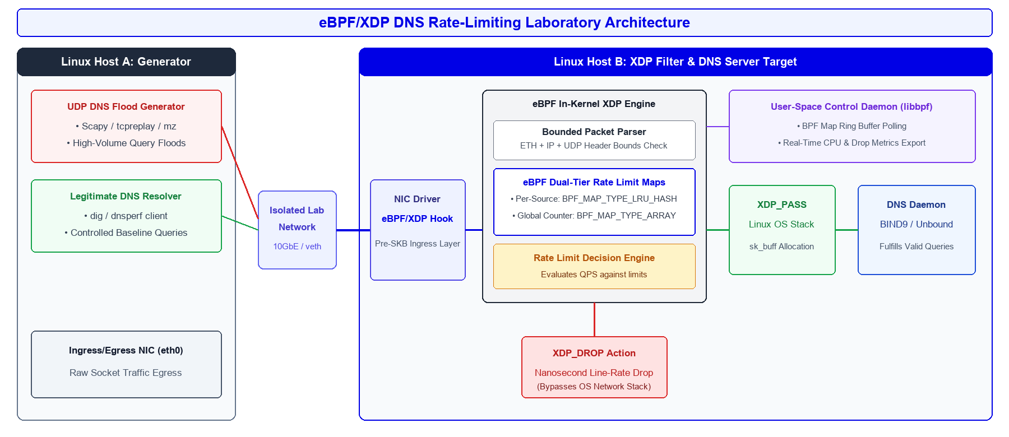
Architecture Design (UML Diagram)
AIORI 3
Solution Architecture & Design
Visual: Flowchart or diagram showing the optimization process.
Figure: System Architecture UML Diagram
Prarthana Puthan Purayil, Richa Felix • A3-PS022-TC050 • October 31, 2026
7 / 11

Slide 8
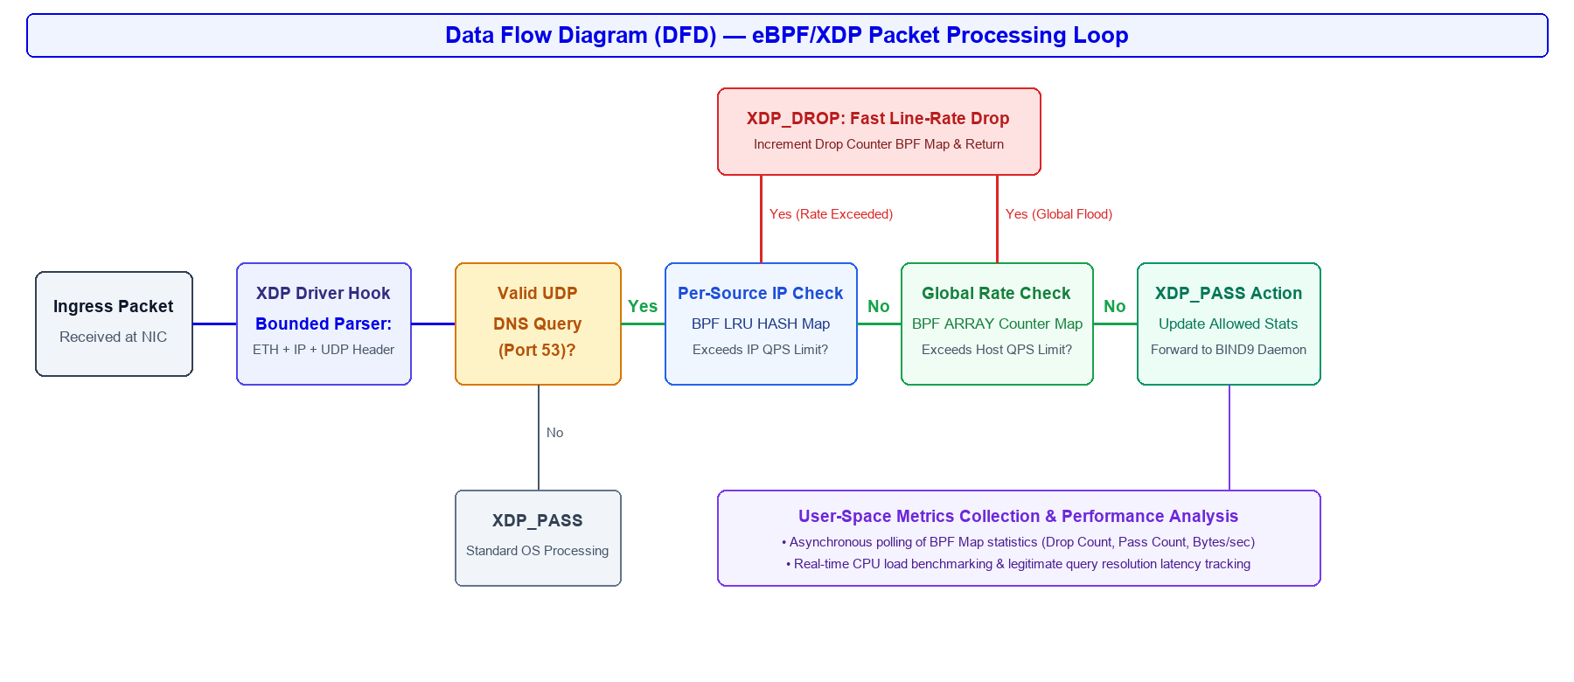
AIORI 3
Data Flow Diagram
Data Flow Diagram
Overview of the architecture. Include the flow chart diagram created earlier. Visual: Diagrams or architecture visuals.
Figure: Data Flow Diagram (DFD)
Prarthana Puthan Purayil, Richa Felix • A3-PS022-TC050 • October 31, 2026
8 / 11

Slide 9
AIORI 3
Deployment Timeline
Deployment Timeline
Clearly define the deployment milestones and methodology.
Dates (2026) | Phase / Milestone | Key Technical Tasks & Deliverables
16 – 17 Oct | Research & Architecture | Analyze DNS RFC specs, eBPF verifier safety rules, threat model, and design dual-tier rate limiting architecture.
18 – 19 Oct | Environment Setup | Provision dual Linux hosts (Host A / Host B), setup veth/isolated lab network, and install BIND9 + LLVM toolchain.
20 – 23 Oct | eBPF/XDP Implementation | Develop XDP C program with bounded UDP parser, BPF_MAP_TYPE_LRU_HASH maps, per-source/global limits, and libbpf loader.
24 – 25 Oct | Baseline Configuration | Configure no-filter control baseline and set up equivalent nftables rate-limiting rulesets for comparative benchmarking.
26 – 28 Oct | Synthetic Flood Testing | Execute flood testing across 3 traffic patterns (Constant UDP flood, Burst DNS flood, Mixed legitimate/flood traffic).
29 – 30 Oct | Performance Evaluation | Collect and analyze CPU load, packet throughput (Mpps), XDP drop ratio, and legitimate DNS query resolution latency.
31 Oct | Finalization & Submission | Package prototype codebase, complete comprehensive technical documentation, and submit final hackathon deliverables.
Prarthana Puthan Purayil, Richa Felix • A3-PS022-TC050 • October 31, 2026
9 / 11

Slide 10
Bibliography
Bibliography I
[1] P. Mockapetris, "Domain Names - Concepts and Facilities," RFC 1034, and "Domain Names - Implementation and Specification," RFC 1035, Internet Engineering Task Force (IETF), Nov. 1987.
[2] Linux Kernel Documentation, "eBPF Documentation & eXpress Data Path (XDP) Specification," kernel.org, 2026. [Online]. Available: https://docs.kernel.org/bpf/
[3] Netfilter Core Team, "nftables: Next-Generation Linux Packet Classification Framework," netfilter.org, 2025. [Online]. Available: https://netfilter.org/projects/nftables/
[4] T. Høiland-Jørgensen, J. D. Brouer, D. Borkmann, J. Fastabend, T. Herbert, and H. B. Christensen, "The eXpress Data Path: Fast Programmable Packet Processing in the Linux Kernel," in Proc. ACM CoNEXT, 2018, pp. 54–66.
[5] A. Vieira, M. Rocha, and R. L. Aguiar, "Fast In-Kernel DDoS Mitigation and Rate Limiting with eBPF/XDP," IEEE Transactions on Network and Service Management, vol. 21, no. 2, pp. 1420–1434, 2024.
Prarthana Puthan Purayil, Richa Felix • A3-PS022-TC050 • October 31, 2026
10 / 11

Slide 11
Thank You for Your Attention!

